Slide 1
Able to Build a web application on modern cloud-based architectures and services.
Notes:
Title - The learning outcome
Subtitle - Duration

Slide 2
In this section, we will discuss:
Application Migration
Cloud Migration Strategy
Benefits of Migrating to the Cloud
Application migration risks
Application migration plan in three stages
Cloud migration checklist
Application migration and IBM Cloud
Notes:
Mention the parent topics one by one. This particular learning outcome has 4 parent topics.

Slide 3
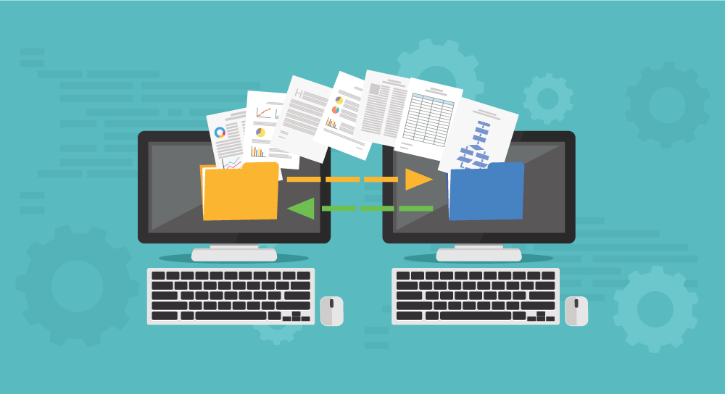
Application Migration
What is application migration?
Application migration is the process of moving a software application from one computing environment to another.
for instance, migrate an application from one data center to another, from an on-premises server to a cloud provider’s environment, or from the public cloud to a private cloud environment.
Image Source: https://wsmintl.com/file/2013/11/data-migration-application.png
Notes:
Left (White Color space):
Title - Parent Topic
Subtitle - Subtopic 1
Body Text - Description in bullets
Right (Grey Color Space):
Body Text - Relevant image (with source)/code snippet
Put reference links in Speaker Notes
Reference:
https://www.tutorialspoint.com/internet_technologies/internet_overview.htm/

Slide 4
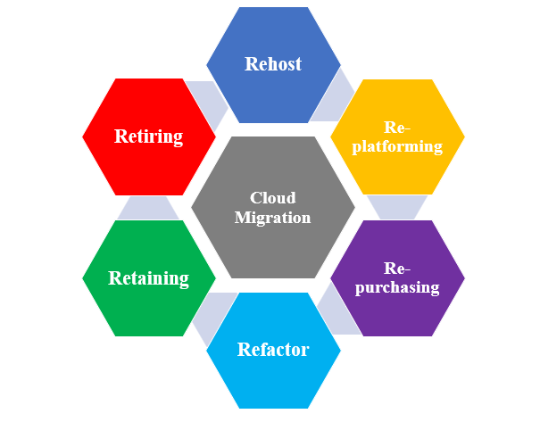
Application Migration
Cloud Migration Strategy
There’s a well-known framework for organizing your strategies for cloud migration: this is known as “The 6 Rs of Cloud Migration”.
Rehost
Replatform
Repurchase
Refactor
Retain
Retire
Image Source: https://i0.wp.com/v3it.com/blog/wp-content/uploads/2021/07/cloud-migration-types.png?resize=605%2C473&ssl=1
Notes:
Left (White Color space):
Title - Parent Topic
Subtitle - Subtopic 1
Body Text - Description in bullets
Right (Grey Color Space):
Body Text - Relevant image (with source)/code snippet
Put reference links in Speaker Notes
Reference:
https://www.tutorialspoint.com/internet_technologies/internet_overview.htm/

Slide 5
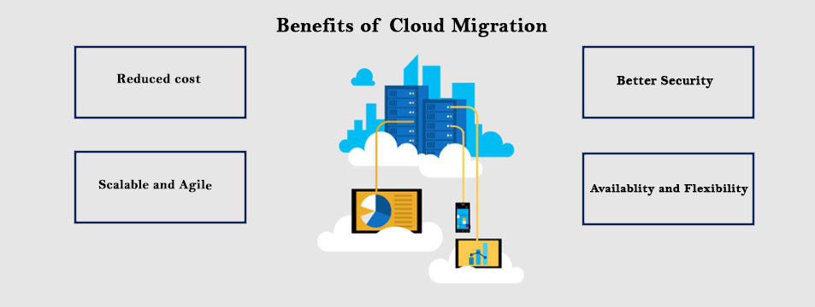
Migrating application to Cloud
Benefits of Migrating to the Cloud
Scalability
Cost
Performance
Digital experience
Image Source: https://www.i2econsulting.com/wp-content/uploads/2020/04/Azure-2-1.jpg
Notes:
Left (White Color space):
Title - Parent Topic
Subtitle - Subtopic 1
Body Text - Description in bullets
Right (Grey Color Space):
Body Text - Relevant image (with source)/code snippet
Put reference links in Speaker Notes
Reference:
https://www.tutorialspoint.com/internet_technologies/internet_overview.htm/

Slide 6
Migrating application to Cloud
Benefits of Migrating to the Cloud
Stakeholders may fear that application migrations might cause disruptions to the business or result in unanticipated costs. The most common risks include the following:
Unforeseen technical challenges
Unanticipated costs
Unexpected downtime
Cultural issues or change management difficulties
Image Source: https://www.i2econsulting.com/wp-content/uploads/2020/04/Azure-2-1.jpg
Notes:
Left (White Color space):
Title - Parent Topic
Subtitle - Subtopic 1
Body Text - Description in bullets
Right (Grey Color Space):
Body Text - Relevant image (with source)/code snippet
Put reference links in Speaker Notes
Reference:
https://www.tutorialspoint.com/internet_technologies/internet_overview.htm/

Slide 7
Migrating application to Cloud
Application migration plan in three stage
Application identification and assessment.
Total cost of ownership (TCO) assessment.
Assess overall risk and project duration
Image Source: https://www.i2econsulting.com/wp-content/uploads/2020/04/Azure-2-1.jpg
Notes:
Left (White Color space):
Title - Parent Topic
Subtitle - Subtopic 1
Body Text - Description in bullets
Right (Grey Color Space):
Body Text - Relevant image (with source)/code snippet
Put reference links in Speaker Notes
Reference:
https://www.tutorialspoint.com/internet_technologies/internet_overview.htm/

Slide 8
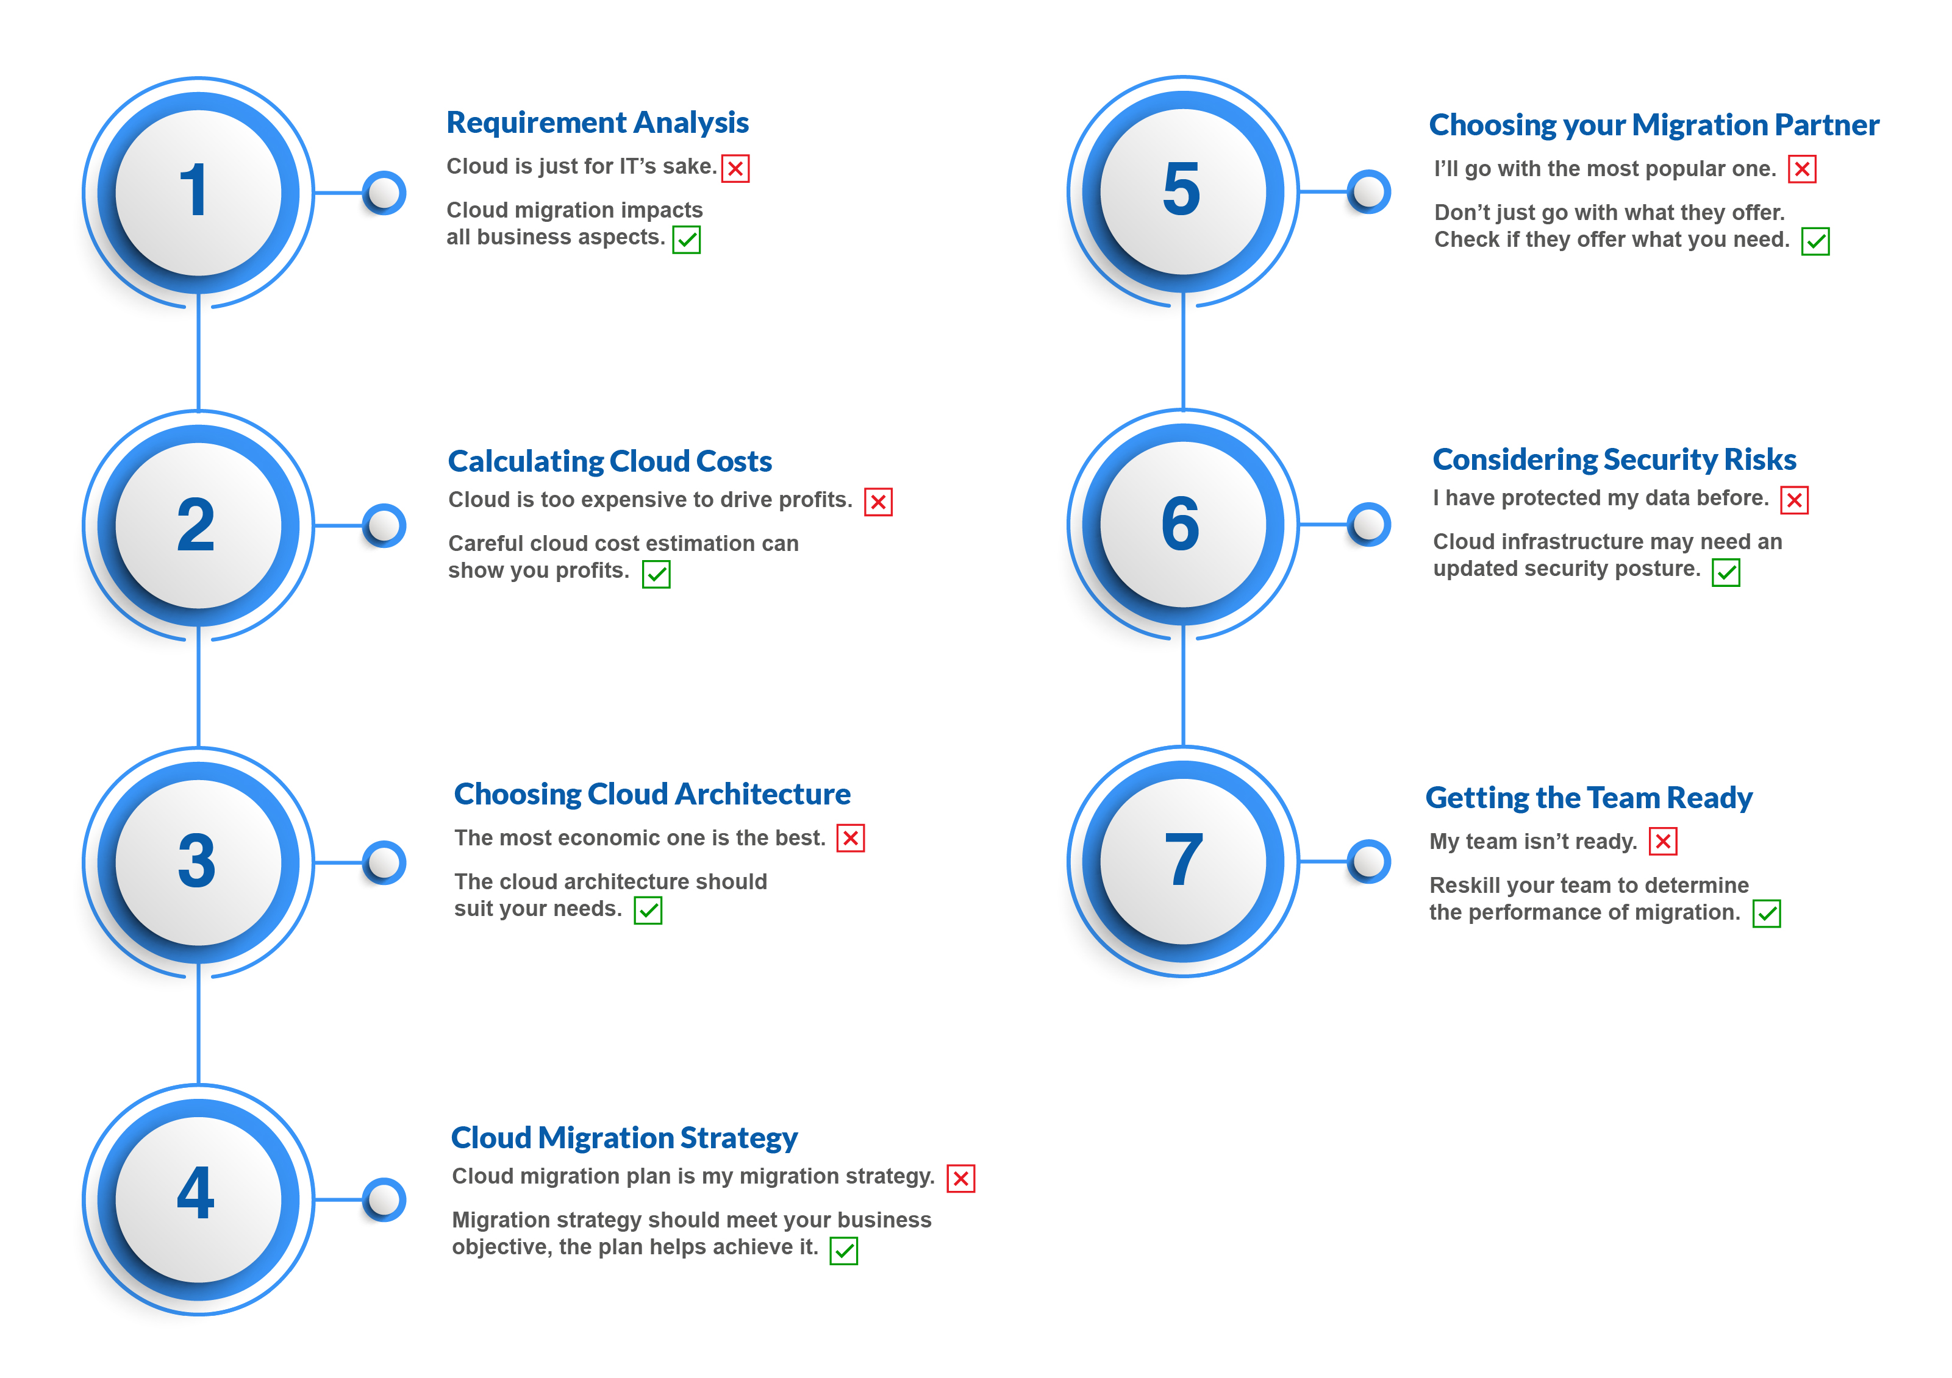
Migrating application to Cloud
Cloud migration checklist
Determine which workloads will be relocated to the cloud and classify them by complexity, size, and production/not production.
Research and select a cloud provider suitable to the workloads being relocated.
Determine if you will need a multicloud approach based on your workloads.
Image Source: https://d2poqm5pskresc.cloudfront.net/wp-content/uploads/2020/11/ATM_Base_concept_Checklist_3.jpg
Notes:
Left (White Color space):
Title - Parent Topic
Subtitle - Subtopic 1
Body Text - Description in bullets
Right (Grey Color Space):
Body Text - Relevant image (with source)/code snippet
Put reference links in Speaker Notes
Reference:
https://www.tutorialspoint.com/internet_technologies/internet_overview.htm/

Slide 9
Migrating application to Cloud
Cloud migration checklist
Perform a cost assessment for the migration.
Assign a team to execute the migration.
Communicate the goals of the migration to the team.
Determine how much of the migration will be handled internally and by the cloud provider.
Image Source: https://d2poqm5pskresc.cloudfront.net/wp-content/uploads/2020/11/ATM_Base_concept_Checklist_3.jpg
Notes:
Left (White Color space):
Title - Parent Topic
Subtitle - Subtopic 1
Body Text - Description in bullets
Right (Grey Color Space):
Body Text - Relevant image (with source)/code snippet
Put reference links in Speaker Notes
Reference:
https://www.tutorialspoint.com/internet_technologies/internet_overview.htm/

Slide 10
Migrating application to Cloud
Cloud migration checklist
Prioritize which workloads to migrate first.
Prepare a plan outlining the roadmap and schedule for the migration.
Ascertain whether the organization already uses any cloud-based applications and whether they should remain as they are or be replaced by new cloud-based services.
Image Source: https://d2poqm5pskresc.cloudfront.net/wp-content/uploads/2020/11/ATM_Base_concept_Checklist_3.jpg
Notes:
Left (White Color space):
Title - Parent Topic
Subtitle - Subtopic 1
Body Text - Description in bullets
Right (Grey Color Space):
Body Text - Relevant image (with source)/code snippet
Put reference links in Speaker Notes
Reference:
https://www.tutorialspoint.com/internet_technologies/internet_overview.htm/

Slide 11
Migrating application to Cloud
Cloud migration checklist
Communicate to all stakeholders what to expect during and post-migration.
Prepare a security plan for migration and post-migration.
Establish KPIs for the migration.
Check in with implementers along the way to review progress.
Test, review, and make adjustments as needed.
Image Source: https://d2poqm5pskresc.cloudfront.net/wp-content/uploads/2020/11/ATM_Base_concept_Checklist_3.jpg
Notes:
Left (White Color space):
Title - Parent Topic
Subtitle - Subtopic 1
Body Text - Description in bullets
Right (Grey Color Space):
Body Text - Relevant image (with source)/code snippet
Put reference links in Speaker Notes
Reference:
https://www.tutorialspoint.com/internet_technologies/internet_overview.htm/

Slide 12
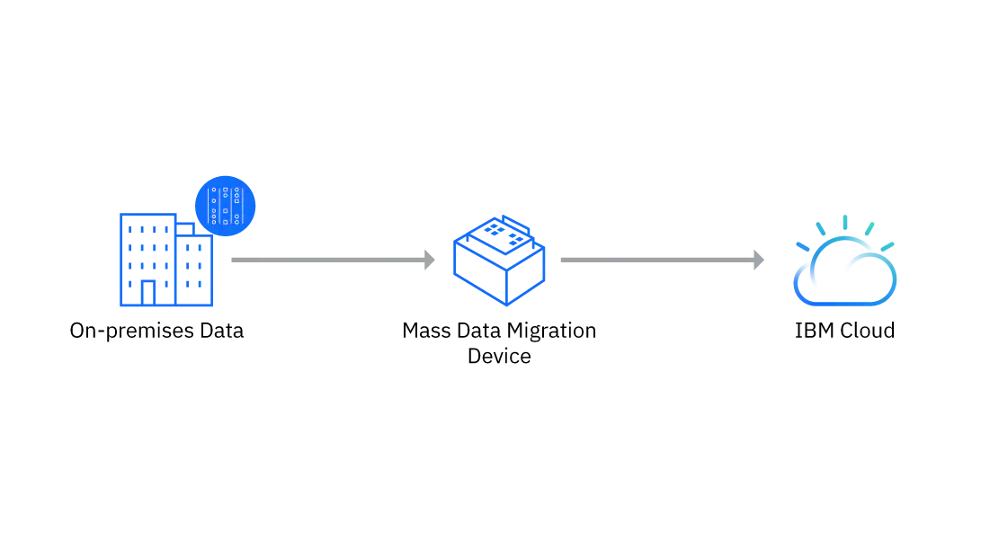
Migrating application to Cloud
Application migration and IBM Cloud
IBM Cloud offers a full suite of cloud migration tools and services, ranging from IBM Assisted Migration Services, which include fully-managed migrations using the customer’s own tools, to seamless lift-and-shift migrations of VMware workloads supported through IBM’s partnership with VMware.
Image Source: https://1.cms.s81c.com/sites/default/files/2021-06-14/cloud-mass-data-migration-moving-to-the-cloud-use-case.png
Notes:
Left (White Color space):
Title - Parent Topic
Subtitle - Subtopic 1
Body Text - Description in bullets
Right (Grey Color Space):
Body Text - Relevant image (with source)/code snippet
Put reference links in Speaker Notes
Reference:
https://www.tutorialspoint.com/internet_technologies/internet_overview.htm/

